Slide 1

Python Control Structures - 1
Conditional statements and loops
Program: EDGE-CSE CUET DIGITAL SKILLS TRAINING
Course: Python (Django) [Intermediate]
Lecture: Training Session-02 Date: 14th September, 2024 Duration: (1 + 1) hours
Instructor: Tanveer Rahman, Sr. Software Engineer, Friends Corp. Chuo-ku, Tokyo, JP shakil10vr@hotmail.com, 01626735005

Slide 2
Introduction to Control Structures
Definition: Control structures are blocks of programming that analyze variables and choose directions in which to go based on given parameters.
Importance: They are essential for decision-making, looping, and controlling the flow of programs.

Slide 3
Conditional Statements
What Are Conditional Statements?
Control the flow based on a condition (True/False).
Python supports:
if statement
if...else
if...elif...else
Syntax:
if condition: # execute code elif condition: # execute other code else: # execute remaining code

Slide 4
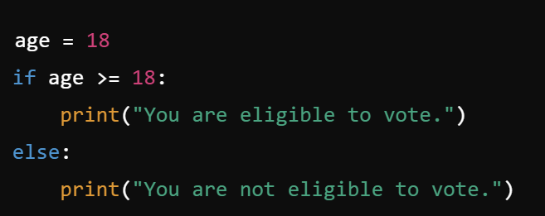
Example of Conditional Statements
Task 1 (15 mins):
Write a program that checks whether a given number is positive, negative, or zero.

Slide 5
Nested Conditional Statements
What Are Nested Conditionals?
* Conditional statements inside another if statement.
* Helps in making complex decisions.
Syntax:
if condition: if another_condition: # execute code

Slide 6
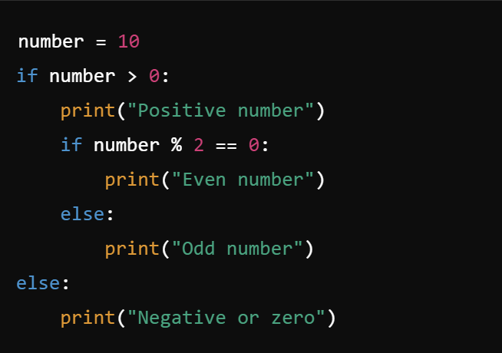
Example of Nested Conditionals
Task 2 (15 mins):
Write a program to check if a student’s grade is 'A', 'B', 'C', or 'Fail' based on marks input.

Slide 7
Loops in Python
Definition: Loops allow you to repeat a block of code multiple times.
for loop
while loop
for Loop Syntax:
for variable in iterable: # execute code
while Loop Syntax:
while condition: # execute code

Slide 8
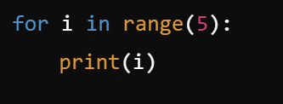
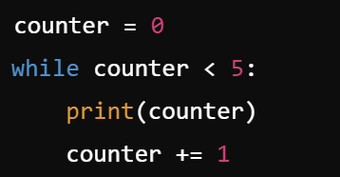
Loop Example
Task 3 (5 mins):
Write a program to print the first 10 natural numbers using a for loop.
Task 4 (15 mins):
Write a program to print the multiplication table of a given number using a while loop.

Slide 9
Break and Continue Statements
break: Terminates the loop.
continue: Skips the current iteration and continues with the next.

Slide 10
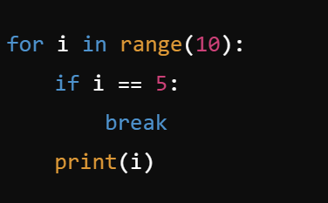
Example of Break and Continue
Task 5 (7 mins):
Write a program that skips printing multiples of 3 between 1 and 10.

Slide 11
RECAP
Conditional Statements:
if, if...else, and if...elif...else statements are used to make decisions based on conditions.
Nested Conditionals:
You can place if statements within other if statements to handle more complex conditions.
Loops:
for loops and while loops allow repetitive execution of code.
Break and Continue:
break terminates the loop, while continue skips the current iteration.

Slide 12

Q&A Session

